Slide 1
COVID-19 Detection
Using Transfer Learning on Chest CT Images
Alexis Bennett

Slide 2
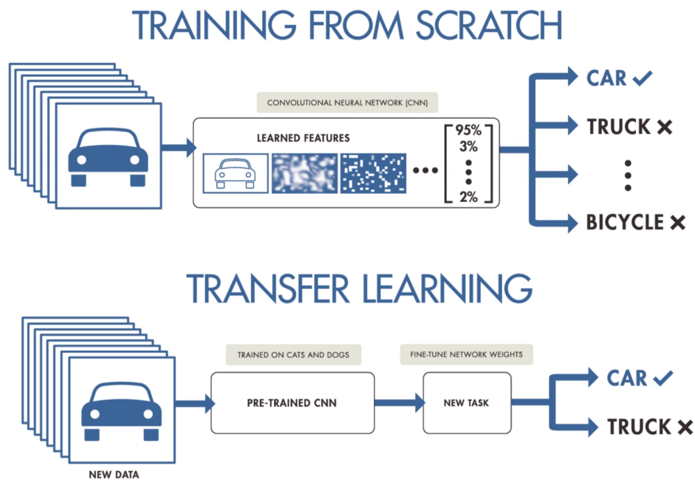
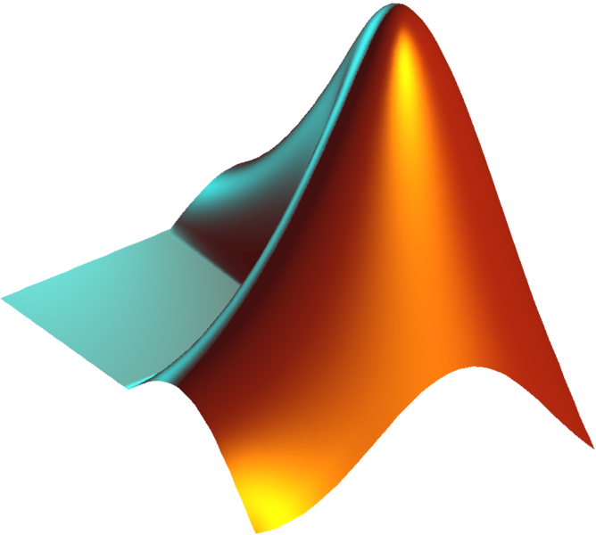
Transfer Learning Using MATLAB
COVID
Non-COVID
https://www.mathworks.com/help/deeplearning/gs/get-started-with-transfer-learning.html

Slide 3
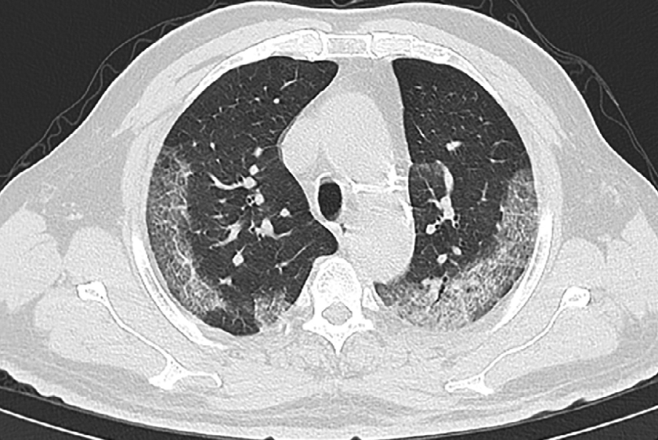
Importance in Diagnosis
Better way to diagnose and slow spread of COVID-19
Future implications of this method
Detect severity of disease
Distinguish from COVID-19 from other bacterial and viral pneumonias

Slide 4
Image Processing
COVID-19 +
COVID-19 -

Slide 5
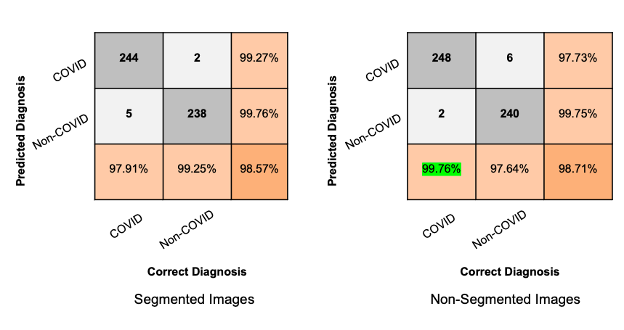
Segmented vs. Non-Segmented Results

Slide 6
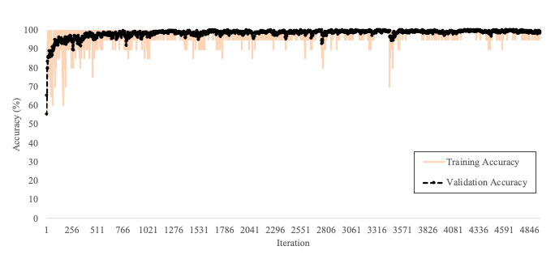
Best Performing Model
Accuracy = 98.71%

